Slide 1
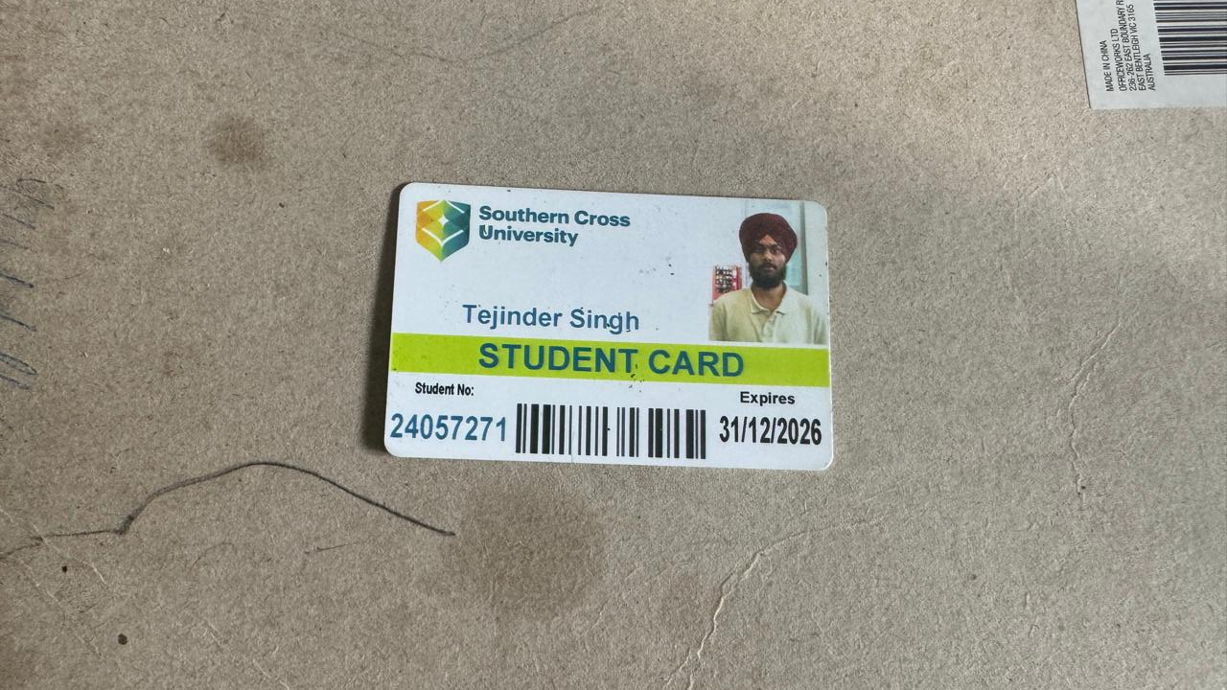
Name : Tejinder Singh
Student ID: 24057271
University: Southern cross university
Unit Designing the user experience

Slide 2
Title
“Changes from Assignment 2 to Assignment 3: UX Enhancements”
Here is the Assessment 2 screenshot of the storyboard which is based on the shepherd boy and the wolf story and the scrrenshot represent some type of idea which tells about the layout navigation system as well as other elements for the assessment(Nielsen, 1994 .

Slide 3
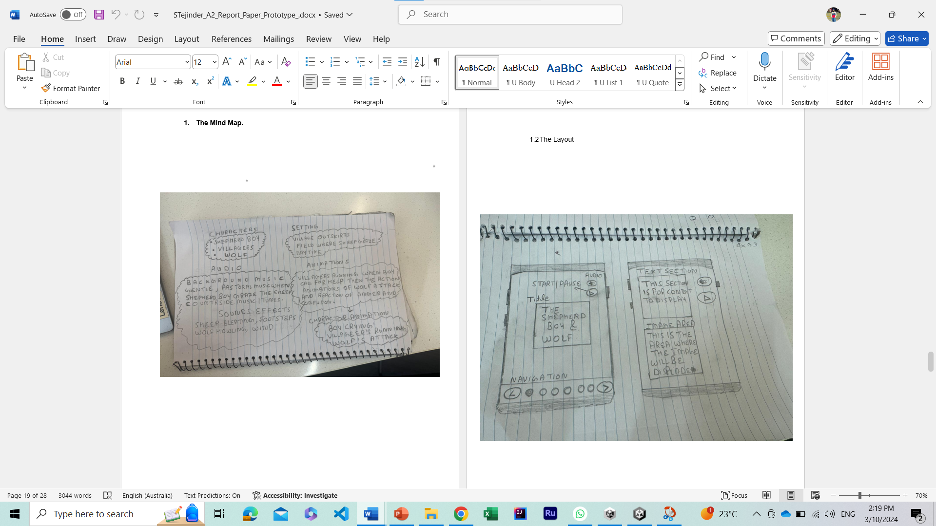
Topic: Changes from Assignment 2 to Assignment 3: UX Enhancements

Slide 4
Feedback from the assessment 2
The feedback from the marking rubric was that the was no rating scale for like or dislike for the user to give them feedback in regards to their experience. Moreover , it is suggested that the adding more interactivity and making feedback mechanisms clearer can improve the things(Shneiderman et al., 2016).

Slide 5
Key Changes in Assignment 3
So there are couple things which have been changed in this case the interactive features have become the main concern for the improvement section as well as the count of the scenes has been taken down.
Improvement in the colour scheme with the use of the canvas assist to make the background more attractive and visual appealing for the assessment 3(Norman, 2023) (Tidwell, 2010).
Here are some screenshot for demonstrating the different between assessment 2 and 3.

Slide 6
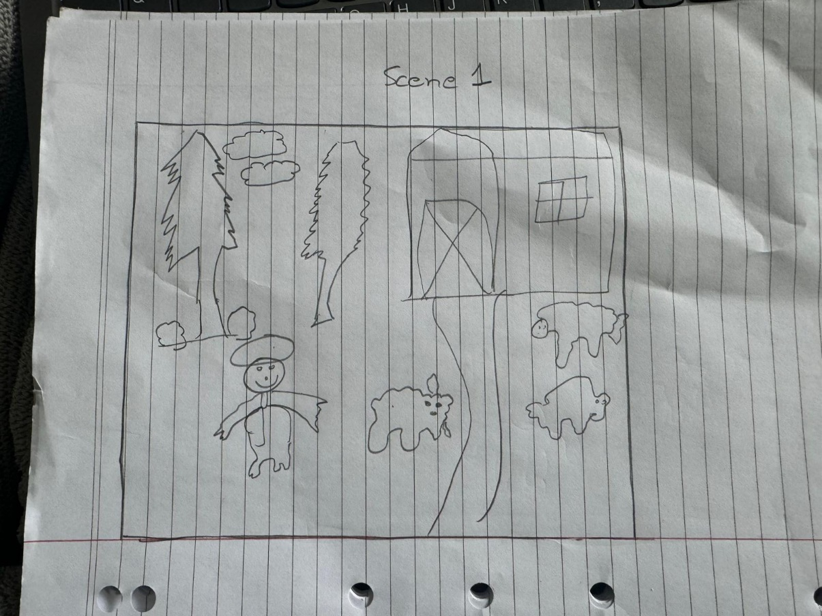
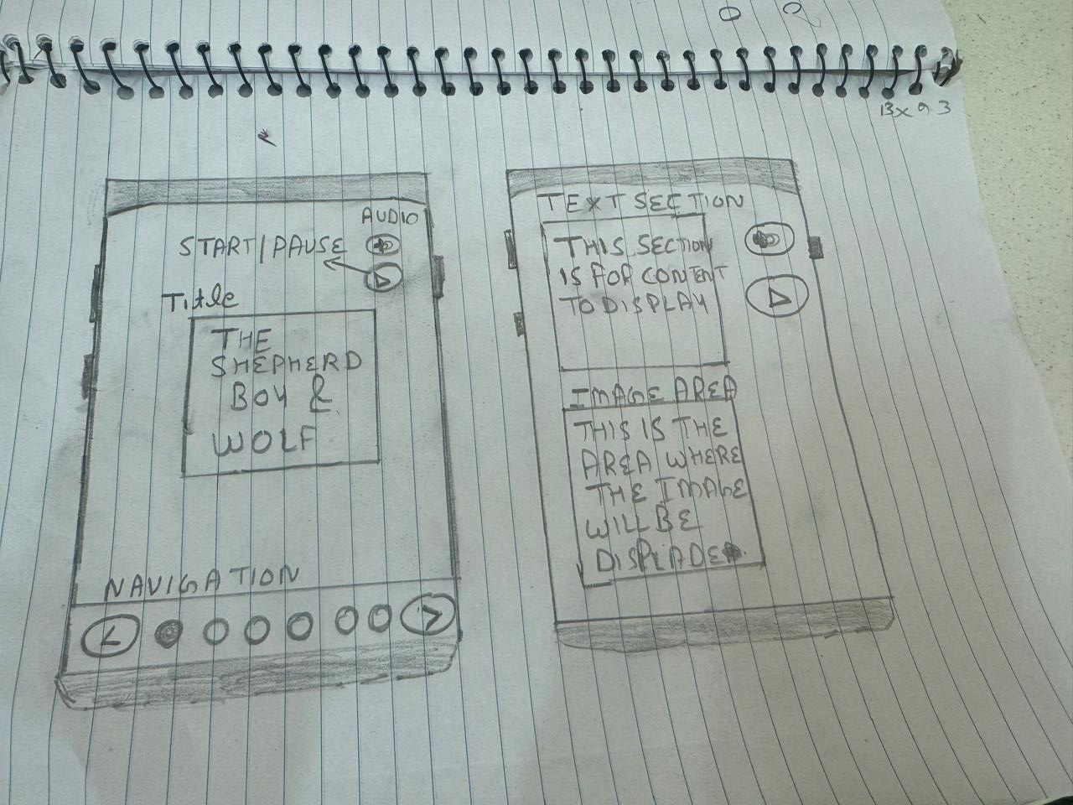
Assignment 3
Assignment 2

Slide 7
Application of UX Principles
I focus on a few fundamental ideas to enhance the user experience. Consistency was a key concept, which made sure that all of the interface's buttons, navigation, and feedback channels worked consistently(Nielsen, 1994) (Shneiderman et al., 2016). Apart from this, i improved accessibility by ensuring text size was appropriate and contrast was sufficient for readability(Gibson, 1977).

Slide 8
Challenges Faced
Technical Challenges: One of the issue while working on this project was initial stage of deciding which type of the unity version is required for this project and the scaling and setting the animation which consume a lot of my time as well as for navigation to the other page there is the need of the button so the script of the coding is required and setting other things were really big concern for this project.
Here is the screen shot on which I am working on and rest of the challenges and how did I overcome will be discussed in the presentation by me.

Slide 9
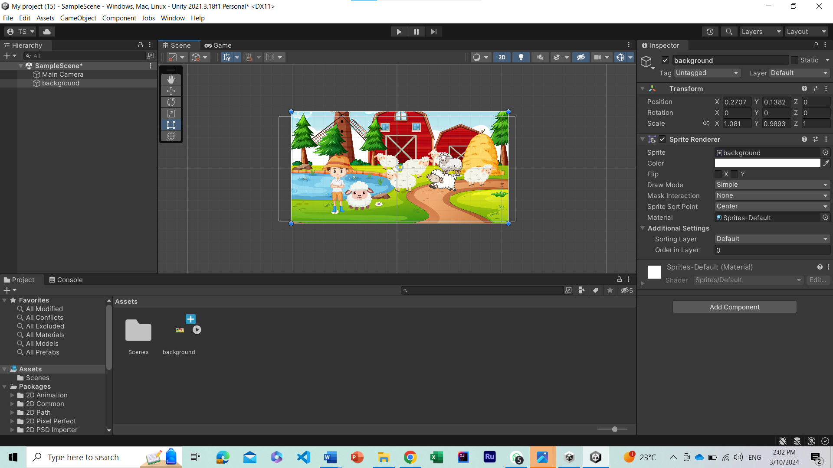

Slide 10
Conclusion:
Last but not least, this is all about the assessment 2 and 3 different and changes were made for the final project after carefully considering the feedback.

Slide 11
Reference
Tidwell, J. (2010). Designing interfaces: Patterns for effective interaction design. O'Reilly Media.
Nielsen, J. (1994). Heuristic evaluation. Usability Inspection Methods.
Shneiderman, B. et al. (2016). Designing the user interface: Strategies for effective human-computer interaction. Pearson.
Unity Technologies. (n.d.). Unity Learn. Retrieved from https://learn.unity.com/
Gibson, J. J. (1977). The theory of affordances. In R. Shaw & J. Bransford (Eds.), Perceiving, acting, and knowing: Toward an ecological psychology.
Norman, D. A. (2023). Design for a better world: Meaningful, sustainable, humanity centered. MIT Press.

